Slide 1
Module 1: Properties and Handling of Particulate Solids (Chapter 28)
Lecture 3
Somak Chatterjee

Slide 2
Mixed Particle Sizes And Size Analysis (Derivation)

Slide 9
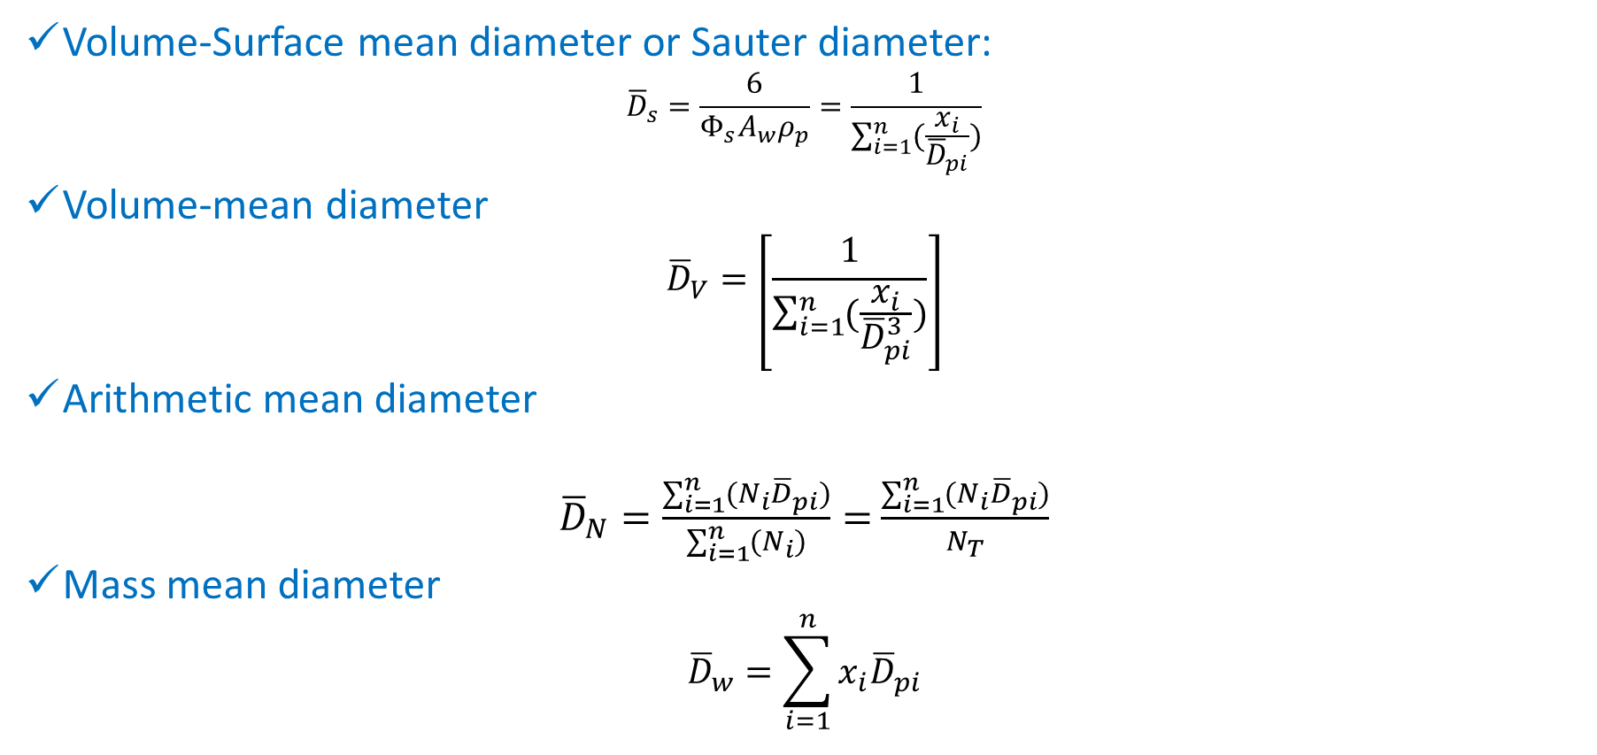
Summary of Average Particle Sizes
Volume-Surface mean diameter or Sauter diameter:
$${\overline{D}}_{s}=\frac{6}{Φ_{s}A_{w}ρ_{p}}=\frac{1}{\sum_{i=1}^{n}{(\frac{x_{i}}{{\overline{D}}_{pi}})}}$$
Volume-mean diameter
$${\overline{D}}_{V}=\left[\frac{1}{\sum_{i=1}^{n}{(\frac{x_{i}}{{\overline{D}}_{pi}^{3}})}}\right]$$
Arithmetic mean diameter
${\overline{D}}_{N}=\frac{\sum_{i=1}^{n}{(N_{i}{\overline{D}}_{pi})}}{\sum_{i=1}^{n}{(N_{i})}}=$ $\frac{\sum_{i=1}^{n}{(N_{i}{\overline{D}}_{pi})}}{N_{T}}$
Mass mean diameter
$${\overline{D}}_{w}=\sum_{i=1}^{n}{x_{i}{\overline{D}}_{pi}}$$

Slide 10
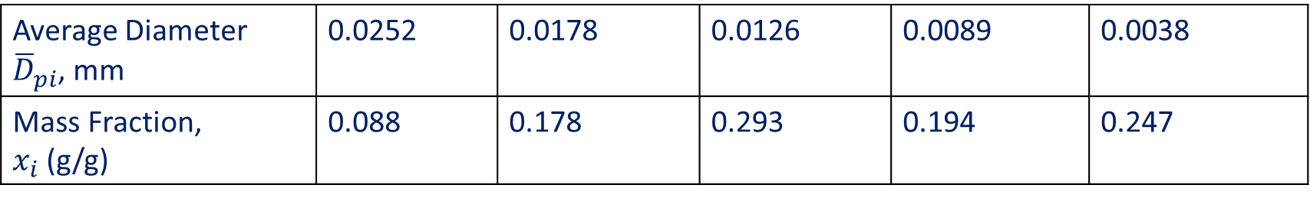
Problem 1: Screen Analysis
Finely divided clay is used as a catalyst in the petroleum industry. It has density of 1.2 g/cc and a sphericity of 0.5. The size analysis is as follows:
Show the differential & cumulative screen analysis of the mixture.
Find the specific surface area and the Sauter mean diameter of the clay material.
Find the number of particles in 1 g sample
Average Diameter ${\overline{D}}_{pi}$, mm | 0.0252 | 0.0178 | 0.0126 | 0.0089 | 0.0038
Mass Fraction, $x_{i}$ (g/g) | 0.088 | 0.178 | 0.293 | 0.194 | 0.247

Slide 11
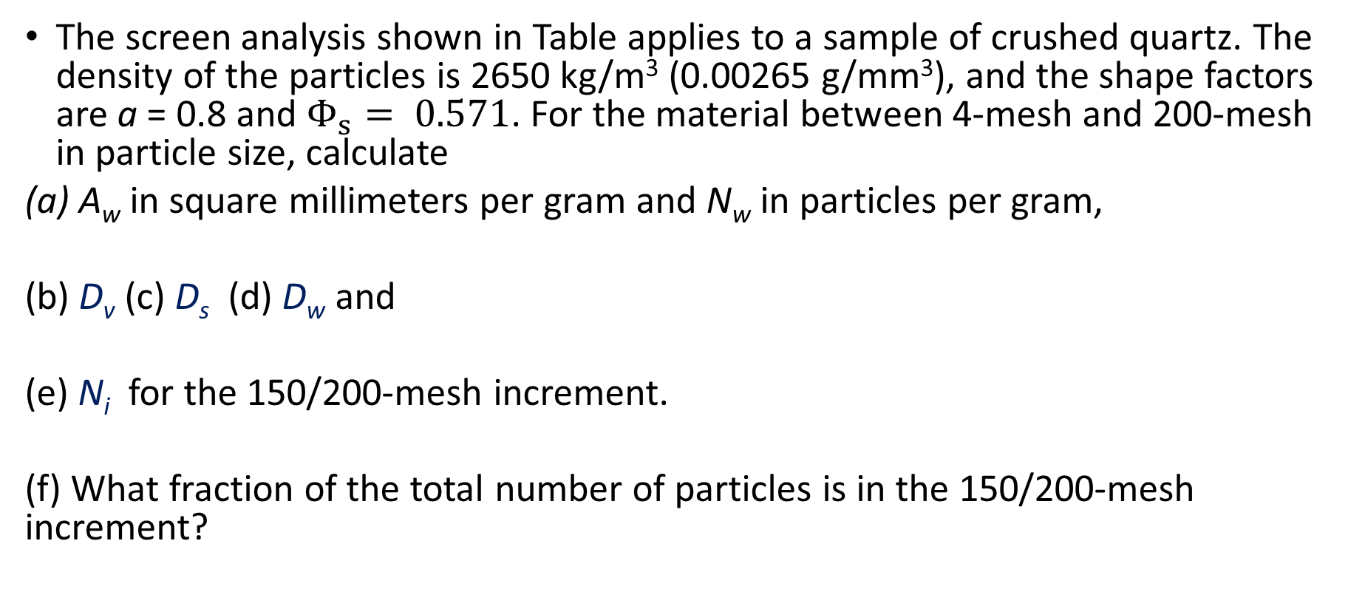
Problem 2: Screen Analysis
The screen analysis shown in Table applies to a sample of crushed quartz. The density of the particles is 2650 kg/m³ (0.00265 g/mm³), and the shape factors are a = 0.8 and $Φ_{s}= 0.571$. For the material between 4-mesh and 200-mesh in particle size, calculate
(a) A_{w} in square millimeters per gram and N_{w} in particles per gram,
(b) D_{v} (c) D_{s} (d) D_{w} and
(e) N_{i} for the 150/200-mesh increment.
(f) What fraction of the total number of particles is in the 150/200-mesh increment?

Slide 12
Numerical Problem

Slide 13
References
Smith, J., Harriott, P., McCabe, W. (2005). Unit Operations of Chemical Engineering. Colombia: McGraw-Hill Education.
Swain, A. K., Patra, H., & Roy, G. K. (2011). Mechanical operations. Tata McGraw Hill.

